Slide 1


Soil Crop Recommendation System using Convolutional Autoencoder (CAE)
Presented by:
Aun Mustansar Hussain (SU92-MSDSW-F25-017)
Muneer Abbas (SU92-MSDSW-F25-016)
Instructor:
Talha Nadeem Shb.
Course:
MS – Data Science (1st Semester)
Domain:
Smart Agriculture / Precision Farming
Superior University, Gold Campus Lahore
Department of CS & IT

Slide 2

Problem Statement & Motivation
Farmers often choose crops based on experience or generic advisories.
This can lead to:
Suboptimal yields
Wasted fertilizers and water
Economic losses and environmental impact
Need: data driven crop recommendation based on soil and climate conditions.
“We want to turn raw soil and weather data into intelligent crop advice.”

Slide 3
Project Objectives
Design a CAE-based deep learning model for soil–crop recommendation.
Implement a Logistic Regression baseline for fair comparison.
Evaluate models using Accuracy, Precision, Recall, F1-score on a held-out test set.
Provide a simple inference pipeline to recommend crops for new soil inputs.
Relate the solution to SDG 2 (Zero Hunger) and SDG 12 (Responsible Consumption and Production).

Slide 4

Dataset and Input Features
Dataset: Kaggle Crop Recommendation Dataset (Crop_recommendation.csv)
~2200 samples, 22 crop classes
Input features (7):
N, P, K
temperature
humidity
ph
rainfall
N
Numeric
Nitrogen content (0-140)
P
Numeric
Phosphorus content (5-145)
K
Numeric
Potassium content (5-205)
temperature
Numeric
Temperature in Celsius (8-43)
humidity
Numeric
Relative humidity (14-100)
ph
Numeric
pH value of soil (3.5-10)
rainfall
Numeric
Rainfall in mm (20-300)
crop
Categorical
22 crop types (e.g., rice, maize, kidneybeans)
Example Record: N: 90, P: 42, K: 43, temperature: 20.87, humidity: 82.00, ph: 6.50, rainfall: 202.93 -> Crop: Rice

Slide 5
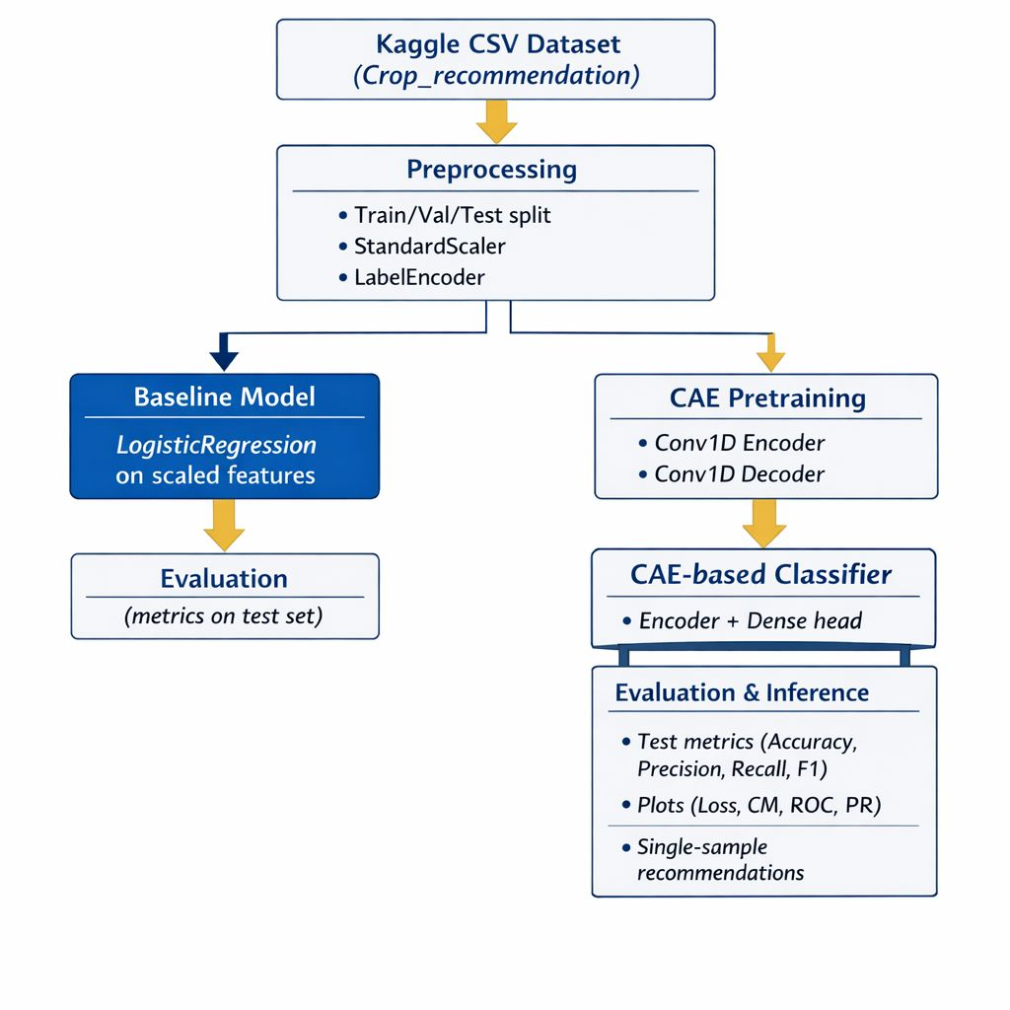

Overall System Pipeline
1
Load and preprocess data
2
Baseline: Logistic Regression on standardized features.
(split, scale, encode labels).
3
Main model: CAE-based classifier:
4
Evaluate on test set and generate plots.
Autoencoder pretraining (unsupervised)
Classifier on top of encoder (supervised).
5
Inference for new soil samples.

Slide 6
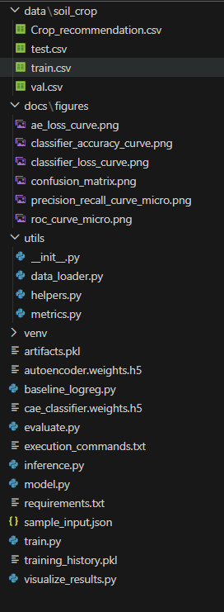

File – Structure of Soil Crop Recommendation System

Slide 7
Baseline Model – Logistic Regression
Input: standardized [N, P, K, temperature, humidity, ph, rainfall].
Model: Multiclass Logistic Regression (max_iter=500, lbfgs).
Purpose:
Simple, interpretable baseline
Ensures CAE improvement is meaningful, not “magic”.
“Before going deep learning, we first checked what a strong classical model can do.”

Slide 8
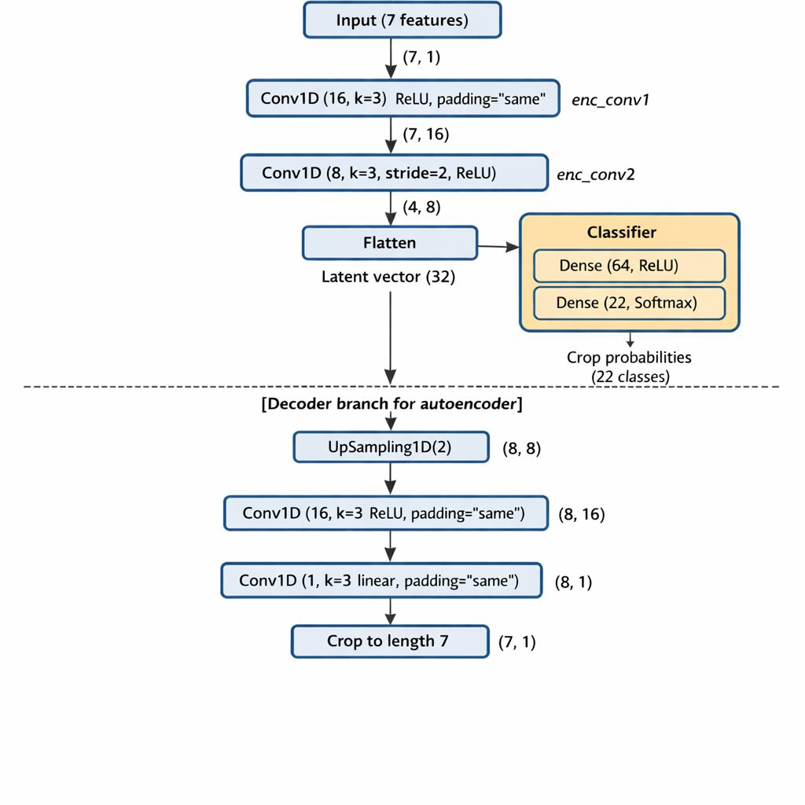

Convolutional Autoencoder (CAE) Architecture
“The autoencoder first learns to reconstruct the input, so the encoder captures useful patterns in soil–climate data.”
Encoder:
Input: (7, 1)
Conv1D(16, k=3, ReLU, same)
Conv1D(8, k=3, stride=2, ReLU, same)
Flatten → latent vector
Decoder:
UpSampling1D(2)
Conv1D(16, k=3, ReLU, same)
Conv1D(1, k=3, linear, same) → cropped to length 7

Slide 9
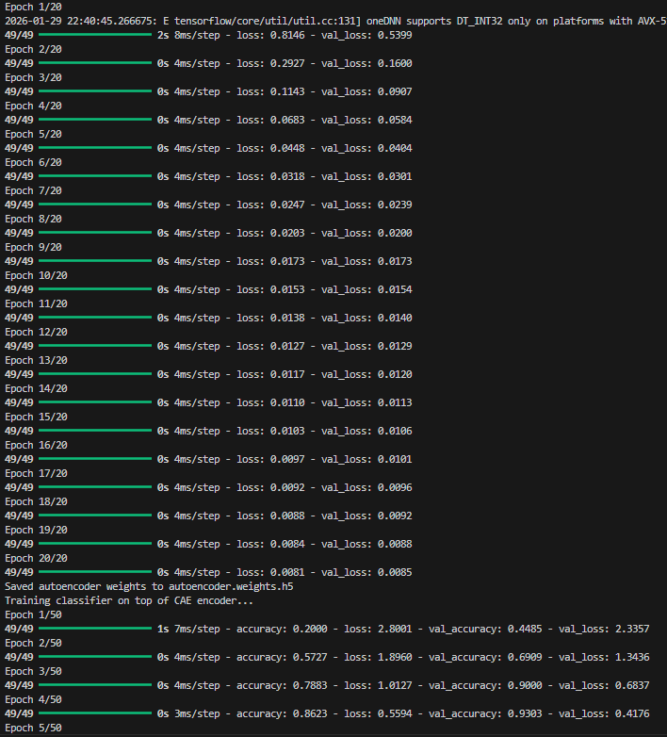


CAE-Based Classifier (Main Model)
Latent vector from encoder →
Dense(64, ReLU)
Dense(22, Softmax)
Training strategy:
Pretrain autoencoder (MSE, 20 epochs).
Train classifier on top of encoder (cross-entropy, 50 epochs).
Implemented in model.py and train.py.

Slide 10
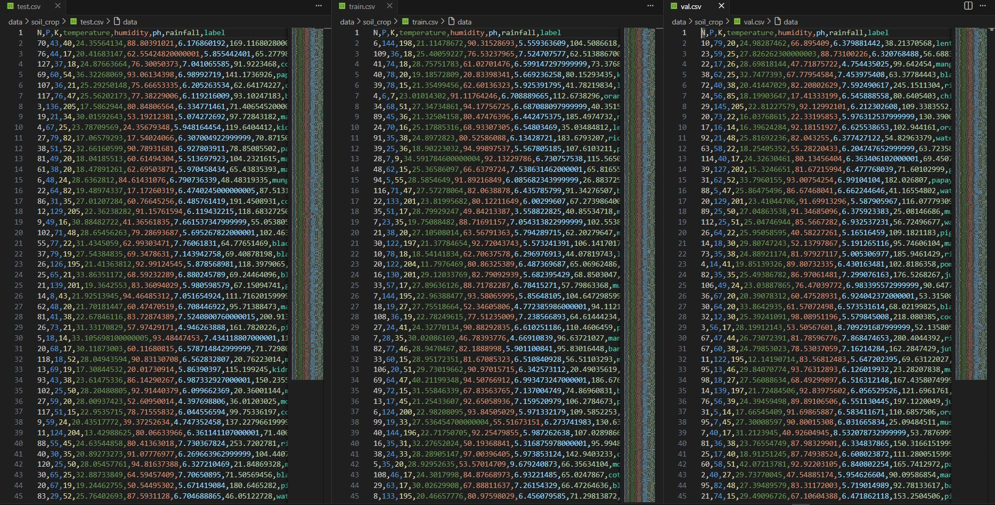
Experimental Setup
Splits:
Train: 1540
Val: 330
Test: 330 (stratified by crop).
Metrics: Accuracy, Precision (weighted), Recall (weighted), F1-score.
Frameworks: TensorFlow/Keras, scikit-learn, Python 3.11.
Environment: Local machine + VS Code (CPU).

Slide 11


Results: Baseline vs CAE-Based Classifier
Model
Accuracy
Precision (w)
Recall (w)
F1 (w)
Logistic Regression (baseline)
97.58%
97.64%
97.58%
97.55%
CAE-based classifier (main)
99.09%
99.15%
99.09%
99.09%
CAE-based model improves accuracy and F1 by ~+1.5 percentage points over an already strong baseline.

Slide 12
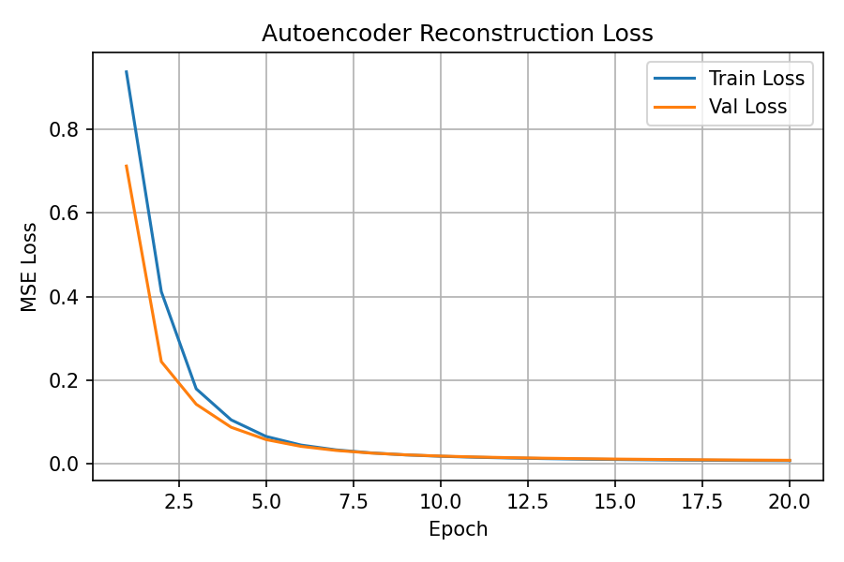
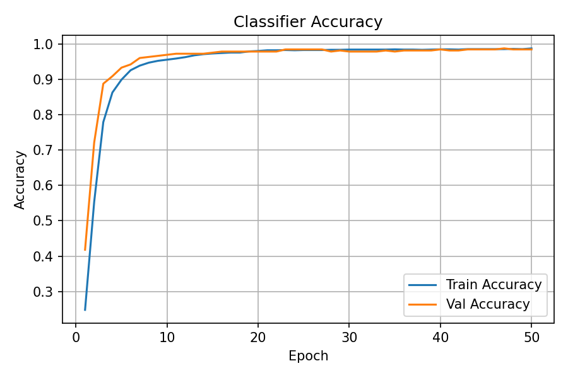
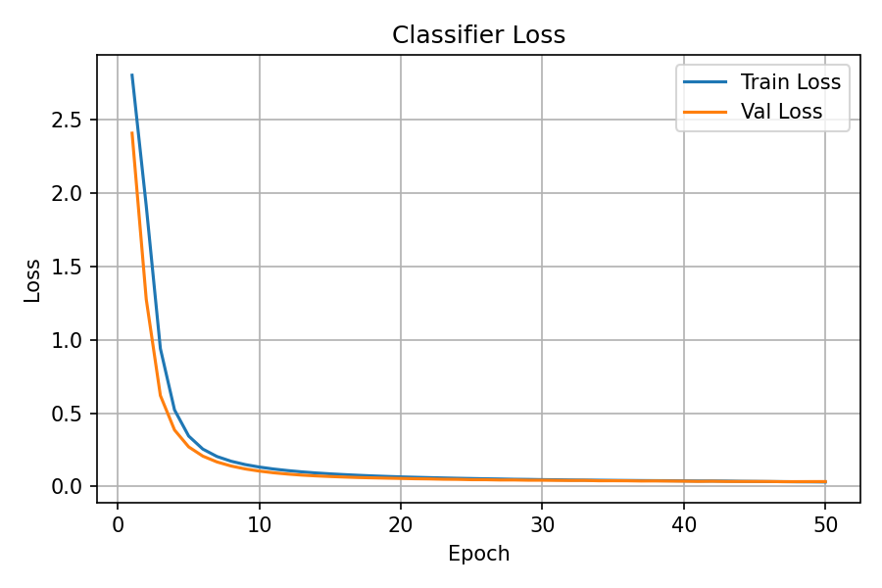
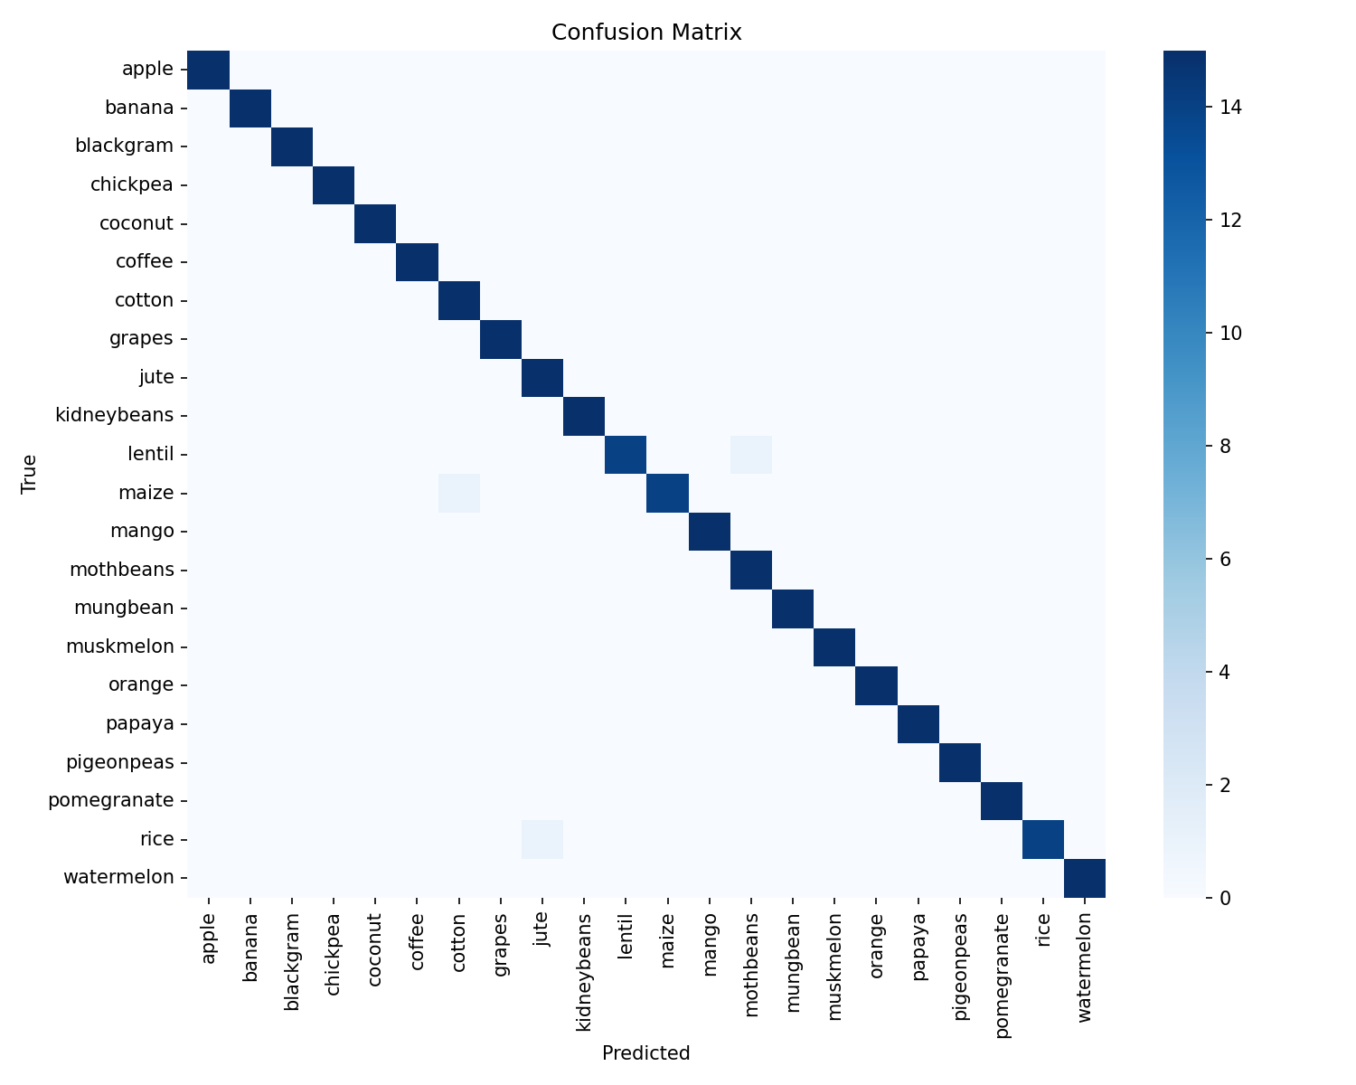
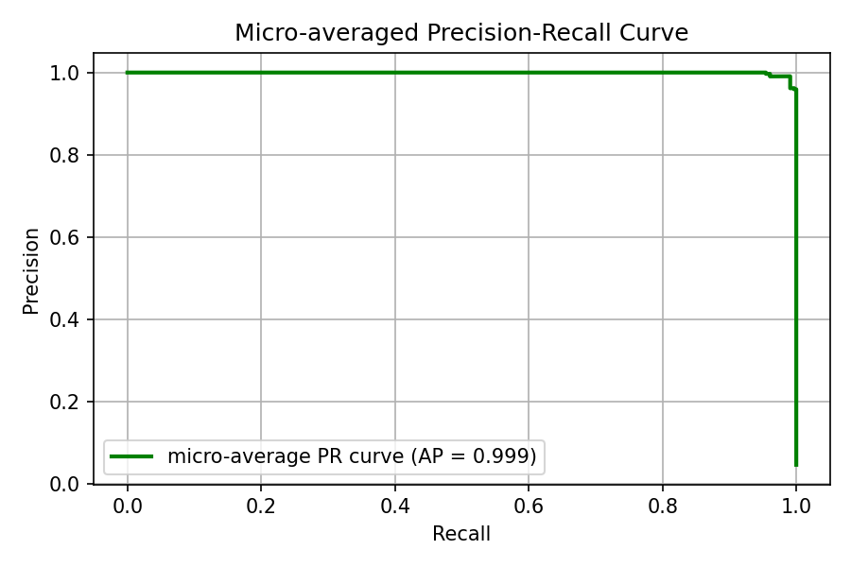
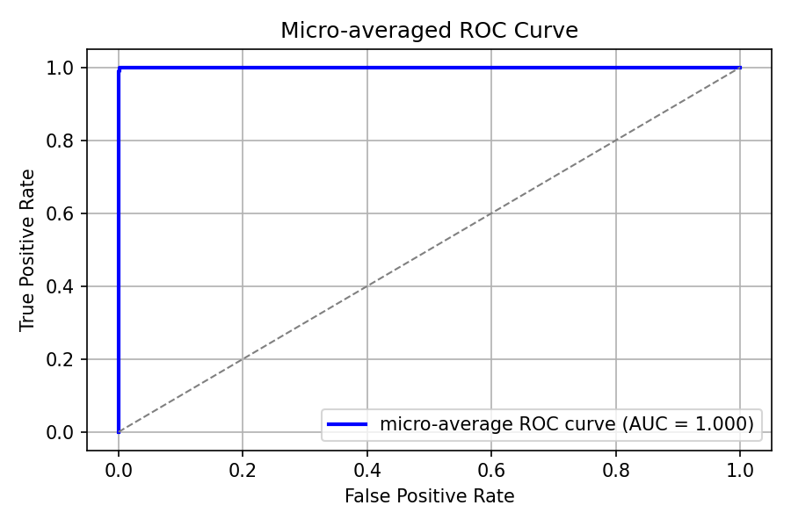
Confusion Matrix and ROC/PR Curves

Slide 13



SDG Alignment (SDG 2 & SDG 12)
SDG 2 – Zero Hunger
1
Better crop–soil matching → improved yields and food security.
Supports smallholders with data-driven recommendations.
SDG 12 – Responsible Consumption and Production
2
Recommends crops that fit existing nutrient and rainfall conditions.
Reduces fertilizer and water wastage → more sustainable production.

Slide 14




Demo: Soil–Crop Recommendation in Action
Show inference pipeline (inference.py):
Input: JSON file with N, P, K, temperature, humidity, pH, rainfall.
Output: Top‑K recommended crops + probabilities.
Example:
Input: [90, 40, 40, 25°C, 80% humidity, pH 6.5, rainfall 220 mm]
Output: e.g., rice (~0.88), jute (~0.12), pigeonpeas (~0.00).

Slide 15
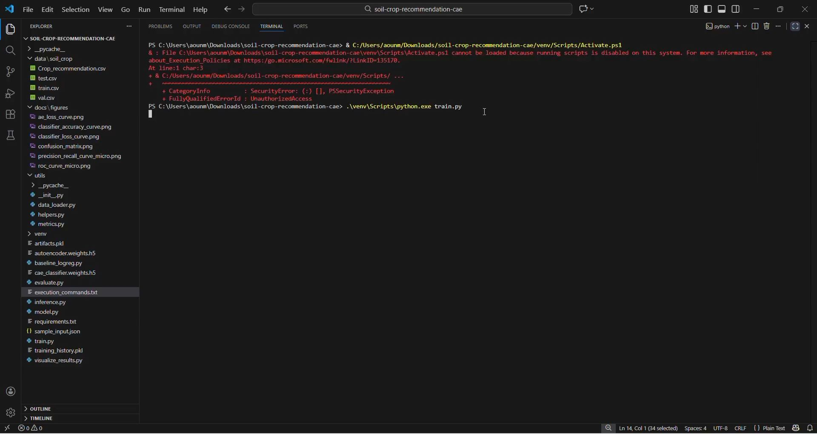


Slide 16


Limitations and Future Work
Limitations:
Trained on a single public dataset (clean, balanced).
Not yet tested on noisy, region-specific real-world data.
Only one deep model and one classical baseline explored.
Future work:
Test on field/lab soil data from local regions.
Add more baselines (Random Forest, XGBoost, TabNet, Transformers).
Build a simple web or mobile app for farmers.

Slide 17


Questions & Discussion
Model choice (why CAE, why Logistic Regression baseline).
SDG connection and real-world deployment.
Limitations and ethical issues (data bias, over‑reliance on models).

